Slide 1
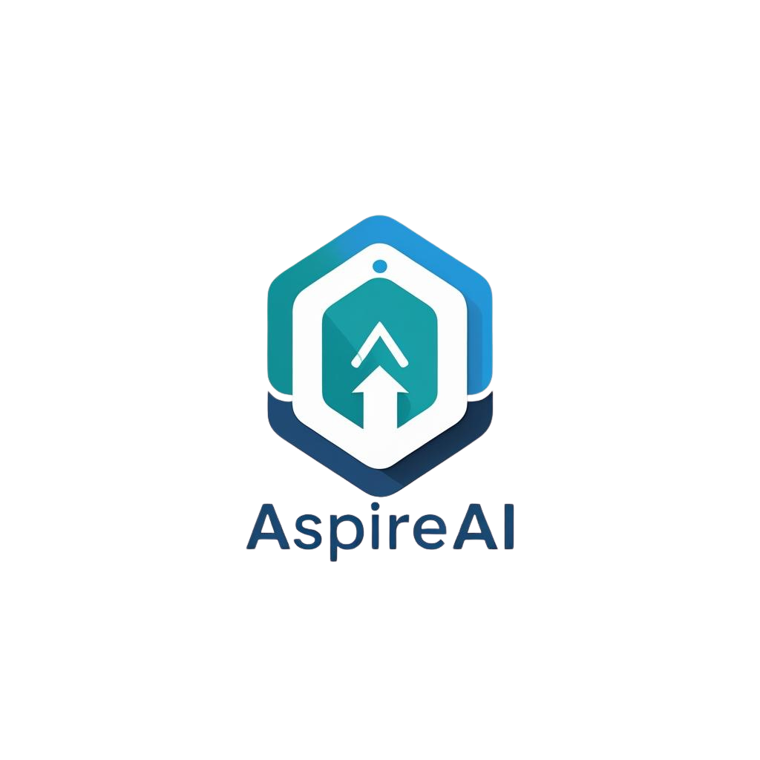





Shaping your future, smarter
Empowering Students with Predictive Intelligence:
A Career Guidance System for Sri Lanka
Group ID: 25-26J-336
|
25-26J-336
|
PAGE: 01
|
2025/09/09
|

Slide 2
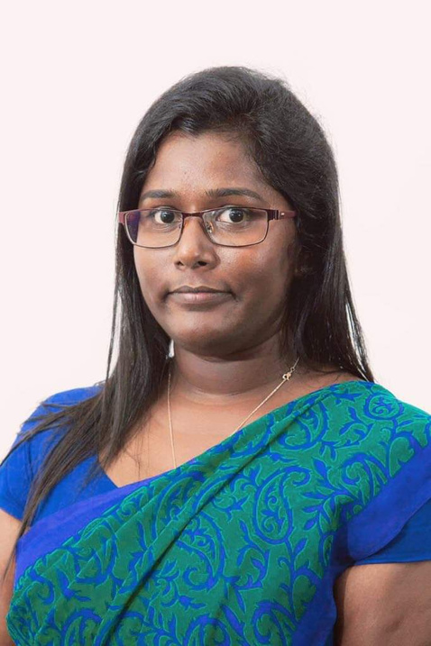

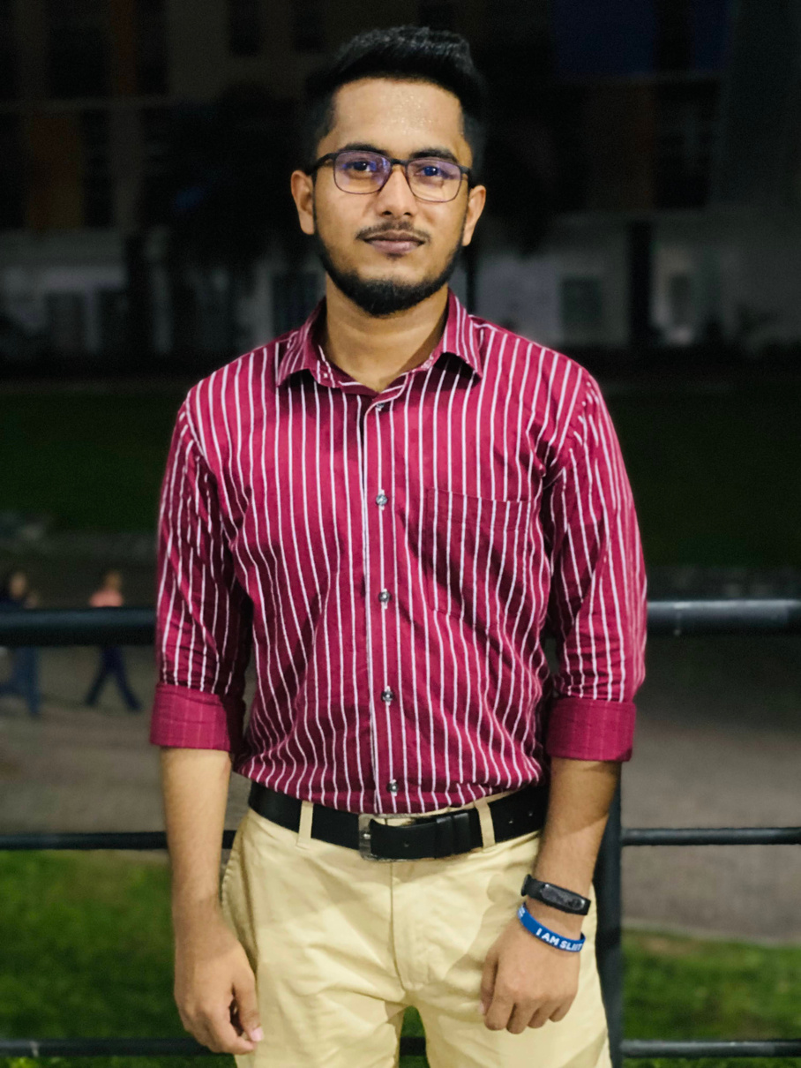

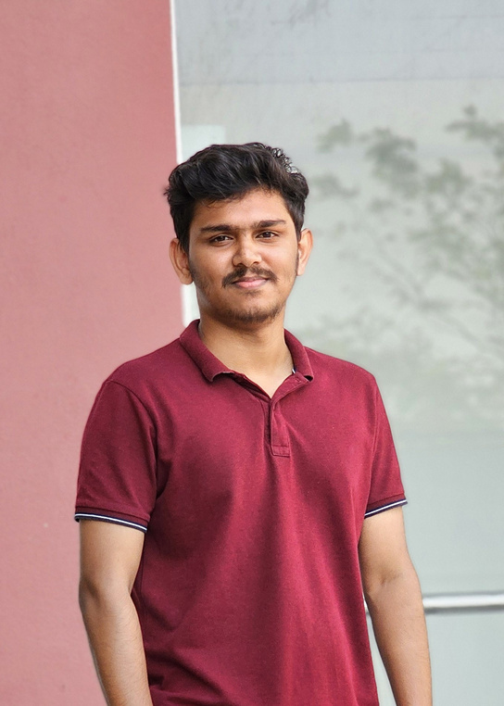
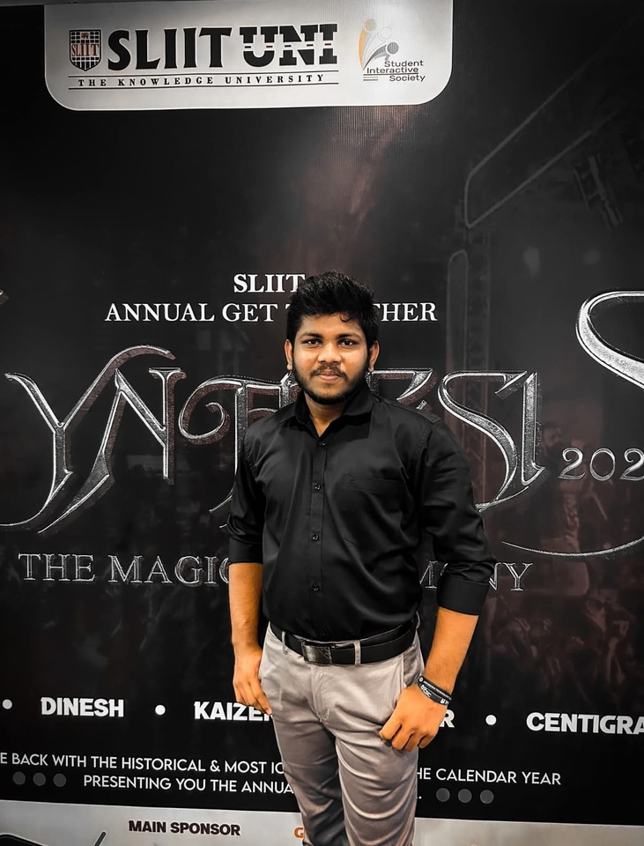
Jenny
Krishara
Poorna Panduwawela
Supervisor
Co-Supervisor
Team Members
|
Ahmed M A A
|
|
|
|
Ahamed A L I
|
|
Areeb Aflah N
|
Bandara R M M KT
25-26J-336
|
PAGE: 02
|
2025/09/09
|

Slide 3
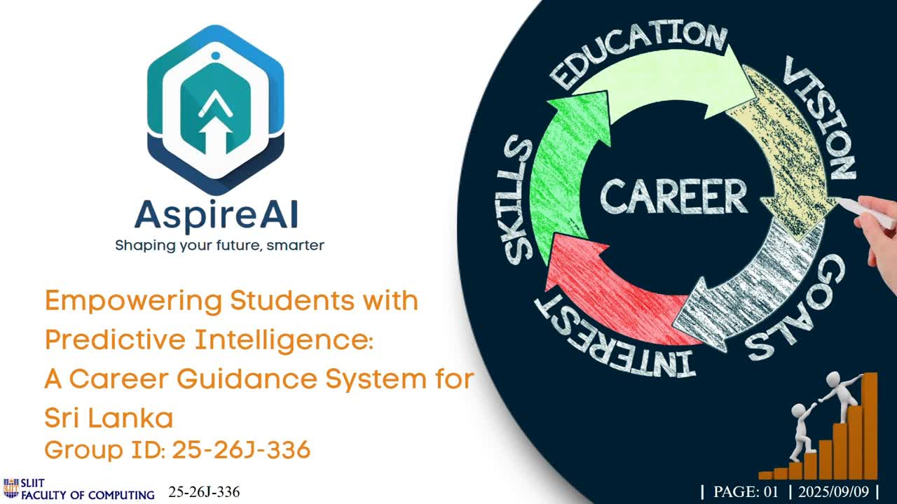

25-26J-336
|
PAGE: 08
|
2025/09/09
|

Slide 4
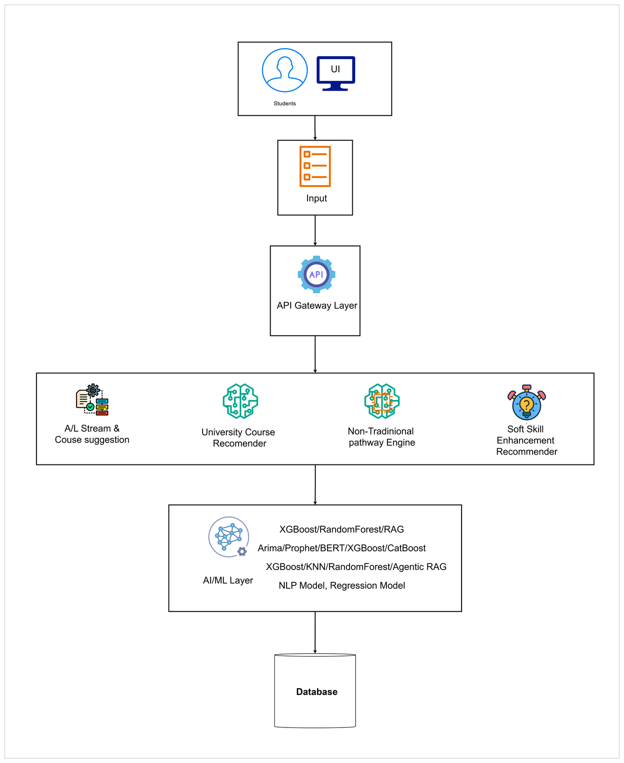
System
Overall Diagram
25-26J-336
|
PAGE: 08
|
2025/09/09
|

Slide 5


AI-Powered Soft Skill Development System for Career Readiness of Sri Lankan Students
BSc (Hons) in Information Technology Specialising in Information Technology
25-26J-336
|
PAGE: 09
|
2025/09/09
|

Slide 6

|
AI-Powered Soft Skill Development System
|
Proven
Gap
Knowledge Gap
In Sri Lanka, students moving from O/L → A/L → University → Career excel in exams but struggle with soft skills, such as communication, problem-solving, and critical thinking.
Current assessments rely mostly on teacher observations or self-reports.
Shortcomings of Existing Systems
Existing tools focus on language learning or workplace training – they don’t target students in academic transitions.
They work in isolation , without Recommendation loops.
Our system integrates AI-driven evaluation, MCQ assessments, personalized recommendations, and progress tracking.
IT22146960
|
Areeb Aflah N
|
25-26J-336
|
PAGE: 10
|
2025/09/09
|

Slide 7

|
AI-Powered Soft Skill Development System
|
Specialization-based
Knowledge
Key Domains
Artificial Intelligence (AI/ML): Speech-to-text, NLP scoring, Adaptive recommendations.
Education Technology : Personalized learning, assessment frameworks.
Software Engineering
Latest Technologies
ASR: Whisper.
NLP: BERT, Sentence Transformers, coherence, and sentiment analysis.
Recommendation: Rule-based mapping with scope to evolve into Reinforcement Learning.
Frontend/Backend: Next.js (UI), FastAPI (backend), PostgreSQL (DB)
IT22146960
|
Areeb Aflah N
|
25-26J-336
|
PAGE: 11
|
2025/09/09
|

Slide 8
|
AI-Powered Soft Skill Development System
|
Specialization-based
Knowledge
Validate Success
Technical Metrics
ASR accuracy - measure Word Error Rate.
NLP scoring - validate against human rubrics.
System latency - target ≤10 seconds.
User Validation: Pilot with 50–100 students to improve accuracy for each soft skill.
Data Availability
Collect speech directly from volunteer students.
quiz data form relevant teachers and books reliable online sources.
All data anonymized, with consent forms and curated open resources for recommendations.
IT22146960
|
Areeb Aflah N
|
25-26J-336
|
PAGE: 12
|
2025/09/09
|

Slide 9
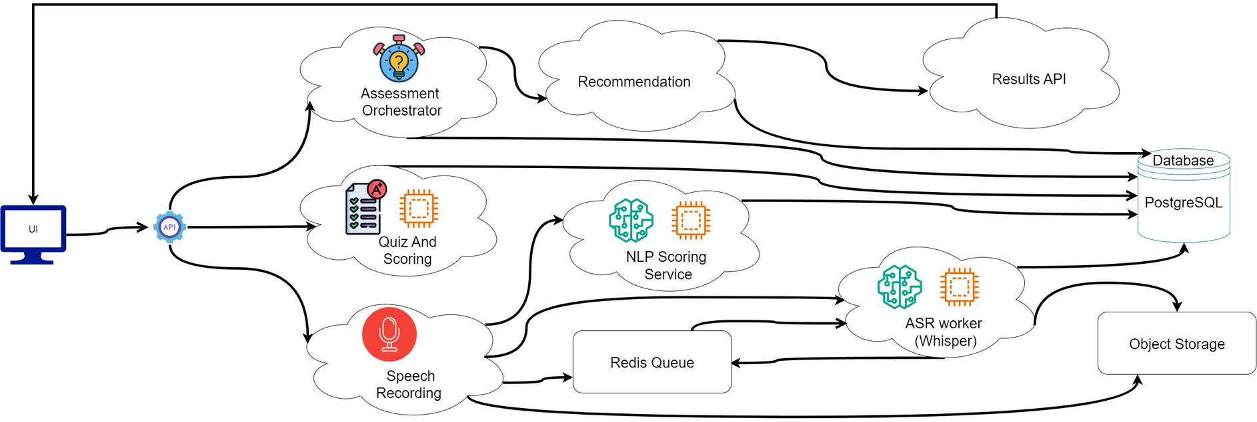


|
AI-Powered Soft Skill Development System
|
System
Overview
Real-World Use
A student logs in, completes a speech task and quizzes, and instantly gets scores and personalized resources.
Over time, they can see an improvement in their dashboard
IT22146960
|
Areeb Aflah N
|
25-26J-336
|
PAGE: 13
|
2025/09/09
|

Slide 10
Learn-to-Earn Diagram Generator for Non-Traditional Learners in Sri Lanka
BSc (Hons) in Information Technology Specialising in Information Technology
IT22077288
|
Ahamed A L I
|
25-26J-336
|
PAGE: 14
|
2025/09/09
|

Slide 11

|
Learn-to-Earn Diagram Generator for Non-Traditional Learners in Sri Lanka
|
Proven
Gap
Proven Gap / Creative Solution
The majority of Sri Lankan learners (80%+) cannot access state universities.
No unified, AI-driven career guidance exists for this demographic.
Creative solution: Personalized Learn-to-Earn diagrams integrating LLMs, ROI analysis, and milestone tracking.
Knowledge Gap / Problem Definition
Existing global tools are not localized.
Local guidance services are fragmented.
IT22077288
|
Ahamed A L I
|
25-26J-336
|
PAGE: 15
|
2025/09/09
|

Slide 12
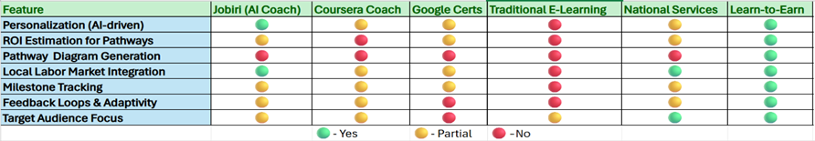
|
Learn-to-Earn Diagram Generator for Non-Traditional Learners in Sri Lanka
|
Proven
Gap
Existing Systems vs Proposed Solution
IT22077288
|
Ahamed A L I
|
25-26J-336
|
PAGE: 16
|
2025/09/09
|

Slide 13

|
Learn-to-Earn Diagram Generator for Non-Traditional Learners in Sri Lanka
|
Specialization-based
Knowledge
Domains of Knowledge Applied
AI/ML – Recommendation engines, embeddings, ROI prediction.
Educational Technology – Visual scaffolding, adaptive feedback.
Database Systems – Store learner profiles and trackings.
Latest Technology in Each Domain
LLMs: OpenAI APIs for Pathway and Diagram Generation.
Vector Databases: pgvector/Pinecone for similarity search.
Web Stack: Next.js + FastAPI, Docker, cloud deployment (Azure).
IT22077288
|
Ahamed A L I
|
25-26J-336
|
PAGE: 17
|
2025/09/09
|

Slide 14

|
Learn-to-Earn Diagram Generator for Non-Traditional Learners in Sri Lanka
|
Specialization-based
Knowledge
Evaluation / Success Metrics
Usability: System Usability Scale ≥ 80.
Pathway Quality: Expert rubric rating clarity ≥ 4/5.
ROI Prediction: Mean Absolute Error (MAE) ≤ 10%.
Outcome: ≥ 15% increase in program enrollment among users.
Data Availability
Data collection: private institutes, vocational centers, and scholarship students.
Minimum sample size: 1,000 learners.
Ethical standards: No personally identifiable information is stored.
IT22077288
|
Ahamed A L I
|
25-26J-336
|
PAGE: 18
|
2025/09/09
|

Slide 15
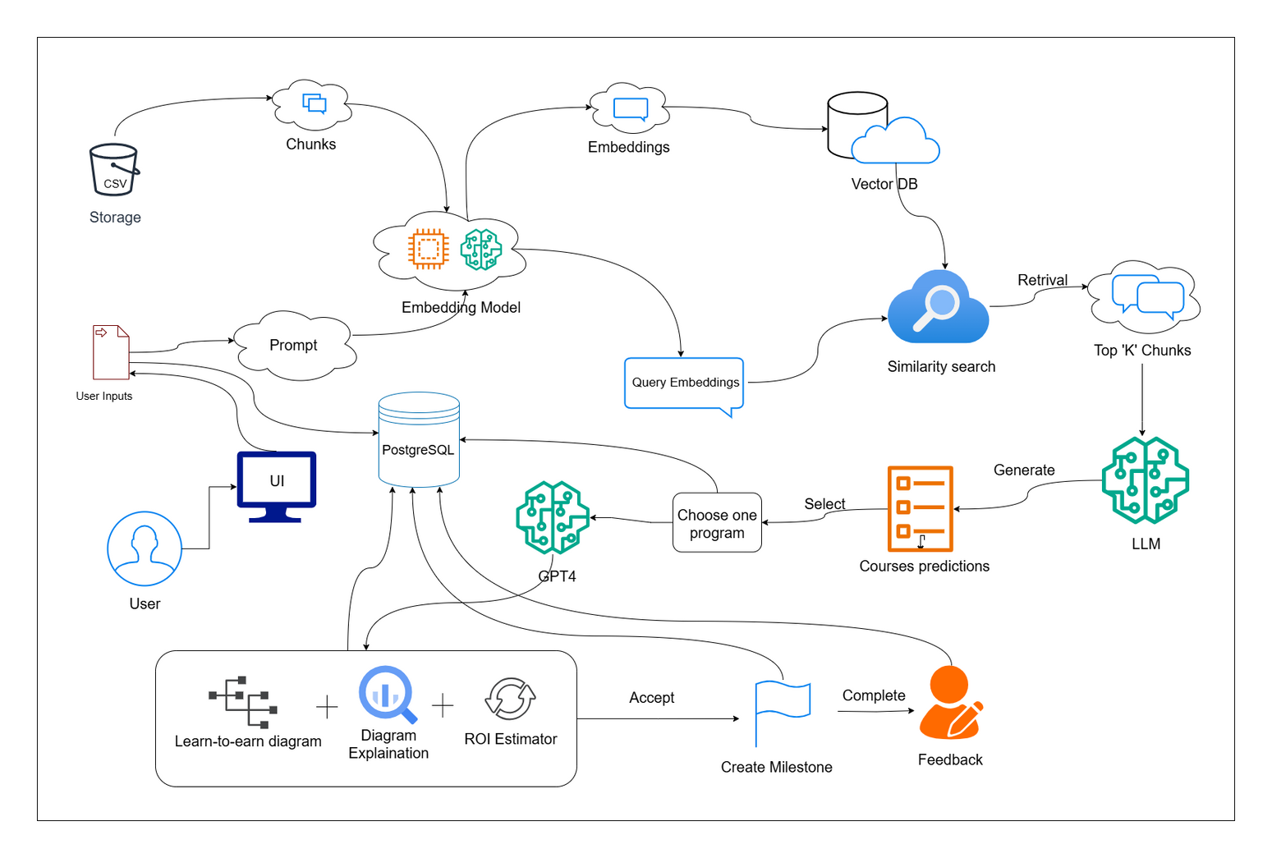

|
Learn-to-Earn Diagram Generator for Non-Traditional Learners in Sri Lanka
|
System Diagram
Real-World Usage
User logs in → fills the survey form → system suggests programs.
The user chooses the preferred program → the system generates a diagram + ROI.
User accepts pathway → sets milestones → completes stages → submits feedback.
Institutions and NGOs can deploy it to guide thousands of learners at scale.
Real-World Use
IT22077288
|
Ahamed A L I
|
25-26J-336
|
PAGE: 19
|
2025/09/09
|

Slide 16

INTELLIGENT STREAM GUIDANCE SYSTEM FOR O/L STUDENTS
BSc (Hons) in Information Technology Specialising in Information Technology
IT2289700
|
Bandara R M M KT
|
25-26J-336
|
PAGE: 20
|
2025/09/09
|

Slide 17


|
Intelligent Stream Guidance System for O/L Students
|
Proven
Gap
Proven Gap / Creative Solution
Students choose streams based on parental pressure.
Current systems lack O/L outcome validation.
Creative solution: Dual-Algorithm ML with improvement guidance.
Knowledge Gap / Problem Definition
Emotion-driven decisions, not evidence-based.
Missing integrated longitudinal analysis system.
IT2289700
|
Bandara R M M KT
|
25-26J-336
|
PAGE: 21
|
2025/09/09
|

Slide 18
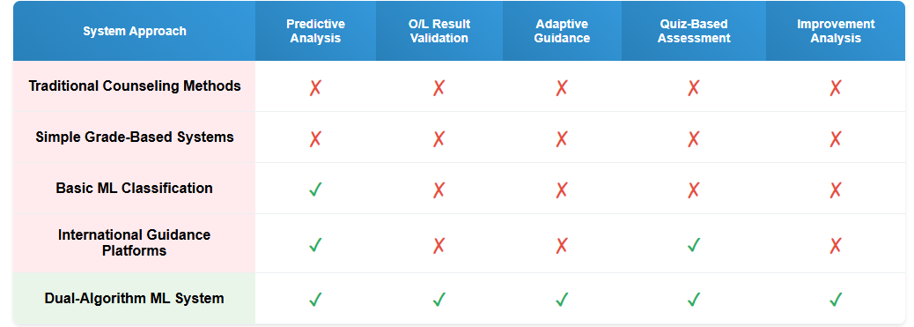
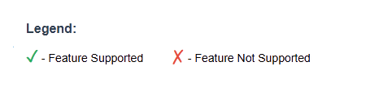
|
Intelligent Stream Guidance System for O/L Students
|
Proven
Gap
Shortcomings of Existing Systems vs Proposed Solution
IT2289700
|
Bandara R M M KT
|
25-26J-336
|
PAGE: 22
|
2025/09/09
|

Slide 19
|
Intelligent Stream Guidance System for O/L Students
|
Specialization-based
Knowledge
Key Domains of Specialization-based Knowledge
Algorithm 1: Stream Prediction
Input: Term test results (grades 9-11)
Training: Historical O/L outcome data
Models: Random Forest + Logistic Regression
Output: Stream compatibility predictions
Algorithm 2: Improvement Analysis
Input: Structured quiz responses
Processing: BERT-based NLP analysis
Output: Specific improvement areas and conceptual gaps
IT2289700
|
Bandara R M M KT
|
25-26J-336
|
PAGE: 23
|
2025/09/09
|

Slide 20

|
Intelligent Stream Guidance System for O/L Students
|
Specialization-based
Knowledge
Latest Technology in Each Domain
Ensemble Learning
Random Forest for pattern recognition + Logistic Regression for probability scoring
Transformer NLP
BERT for semantic understanding of structured quiz responses
Temporal Validation
Post-O/L outcome verification for adaptive recommendations
Multi-Modal Assessment
Combined quantitative (grades) and qualitative (quiz) analysis
IT2289700
|
Bandara R M M KT
|
25-26J-336
|
PAGE: 24
|
2025/09/09
|

Slide 21

|
Intelligent Stream Guidance System for O/L Students
|
Specialization-based
Knowledge
Evaluation / Success Metrics
O/L Validation
Post-Result Verification
NLP Analysis
Quiz Understanding Assessment
Validation Methodology
Train models on historical term test → O/L outcome pairs for predictive accuracy
Validate post-O/L recommendations against actual student capability and performance
Measure improvement suggestion effectiveness through follow-up assessments
IT2289700
|
Bandara R M M KT
|
25-26J-336
|
PAGE: 25
|
2025/09/09
|

Slide 22
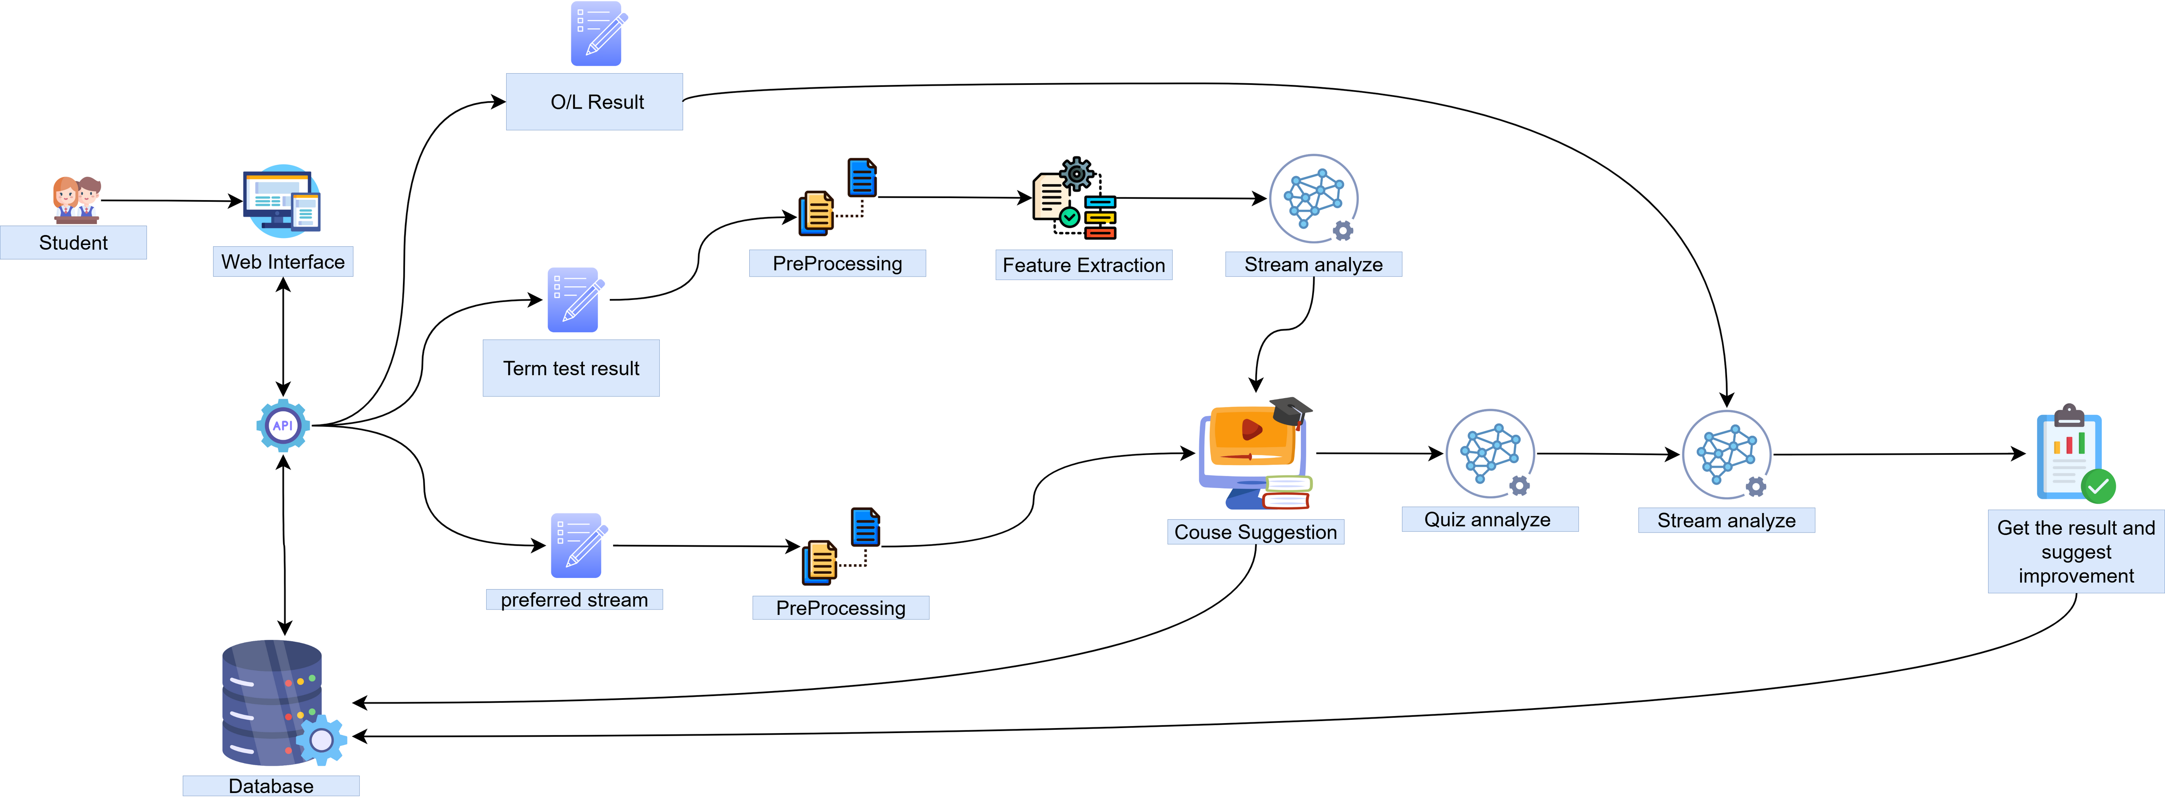
|
Intelligent Stream Guidance System for O/L Students
|
System
Overview
Real-world
Usage
Pre-O/L: Predictive guidance based on academic patterns
Post-O/L: Adaptive recommendations based on actual results
Continuous: Improvement tracking and resource suggestions
IT2289700
|
Bandara R M M KT
|
25-26J-336
|
PAGE: 26
|
2025/09/09
|

Slide 23
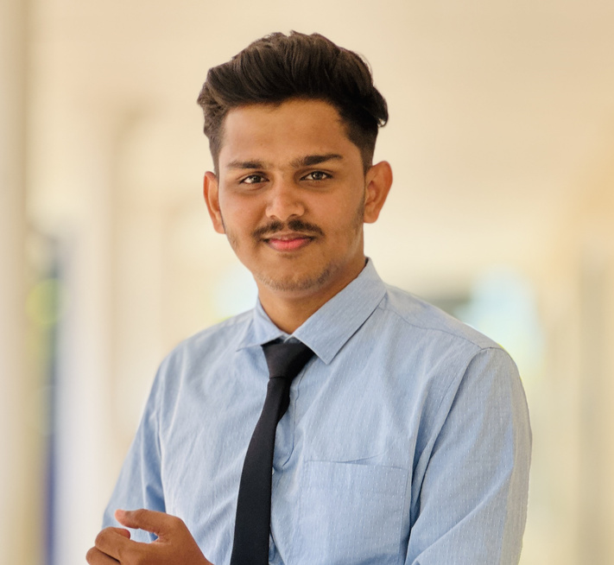
Cutting-Edge AI-Driven University Course Prediction System for Sri Lankan A-Level Students
BSc (Hons) in Information Technology Specialising in Information Technology
IT22079572
|
Azaam M A A
|
25-26J-336
|
PAGE: 27
|
2025/09/09
|

Slide 24
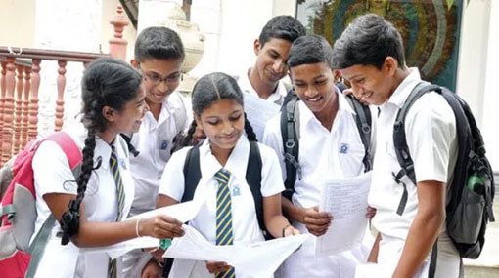
|
Cutting-Edge AI-Driven University Course Prediction System for Sri Lankan A-Level Students
|
Proven
Gap
Proven Gap / Creative Solution
Problem: Manual UGC admissions cause delays, errors, inequities.
Gap: No AI system for Z-score forecasting, guidance, or aptitude prep.
Solution: ARIMA/Prophet cutoffs, BERT aptitude quizzes, weighted recommendations, career quiz, scalable fair platform.
Knowledge Gap / Problem Definition
EDM/AI: Predict admissions but ignore Z-scores & quotas.
Statistical: Improve fairness, no real-time forecasting/personalization.
Early Systems: Eligibility checks only, no aptitude/fairness modules.
Gap: No unified system with forecasting, NLP (BERT), weighted scoring, fairness audits for A/L students.
IT22079572
|
Azaam M A A
|
25-26J-336
|
PAGE: 28
|
2025/09/09
|

Slide 25
|
Cutting-Edge AI-Driven University Course Prediction System for Sri Lankan A-Level Students
|
Specialization-based
Knowledge
Domains of Knowledge Applied
AI/ML : ARIMA/Prophet for Z-score based forecasts, weighted scoring for course ranking.
LLMs: BERT for aptitude quizzes, OpenAI GPT for pathway explanations.
Educational Technology: Next.js UI with Tailwind CSS/Chart.js, FastAPI backend for accessibility.
Database Systems: PostgreSQL for data storage, ChromaDB for similarity search.
Latest Technology in Each Domain
LLMs: Grok 2 (reasoning), BERT.
Vector Databases: Chroma (indexing), Pinecone 4.0 (real-time).
Web Stack: Next.js , Tailwind CSS (design), FastAPI (async).
IT22079572
|
Azaam M A A
|
25-26J-336
|
PAGE: 29
|
2025/09/09
|

Slide 26
|
Cutting-Edge AI-Driven University Course Prediction System for Sri Lankan A-Level Students
|
Specialization-based
Knowledge
Evaluation / Success Metrics
Usability: Achieve a System Usability Scale score of ≥ 90.
Pathway Quality: Attain an expert rubric rating of clarity ≥ 4.5/5.
Z-Score Prediction Accuracy: Maintain a Mean Absolute Error (MAE) ≤ 0.05 for time series models.
Outcome: Realize a ≥ 45% increase in successful UGC program enrollment among system users.
Data Availability & Ethical Clearance
Data Sources: UGC records, past Z-scores, aptitude papers, lecturer models, and student feedback.
Sample Size: 1,000+ University learners across districts for robust training/validation.
Ethical Standards: No personal data stored; anonymization + encryption in PostgreSQL/ChromaDB.
Compliance: Transparent policies ensuring fairness and trust for underserved groups.
IT22079572
|
Azaam M A A
|
25-26J-336
|
PAGE: 30
|
2025/09/09
|

Slide 27
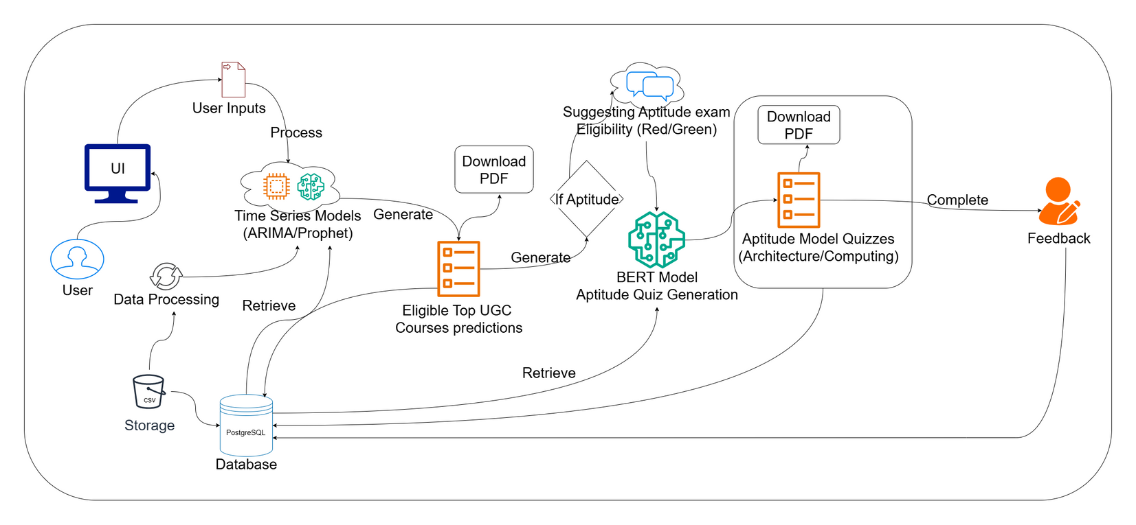
|
Cutting-Edge AI-Driven University Course Prediction System for Sri Lankan A-Level Students
|
System
Overview
Real-World Use
AI system forecasts Z-scores, ranks courses, and provides BERT-based aptitude quizzes with a career survey.
Impact: Rural and underserved students get real-time, fair, and transparent guidance for informed higher education choices.
IT22079572
|
Azaam M A A
|
25-26J-336
|
PAGE: 31
|
2025/09/09
|

Slide 28

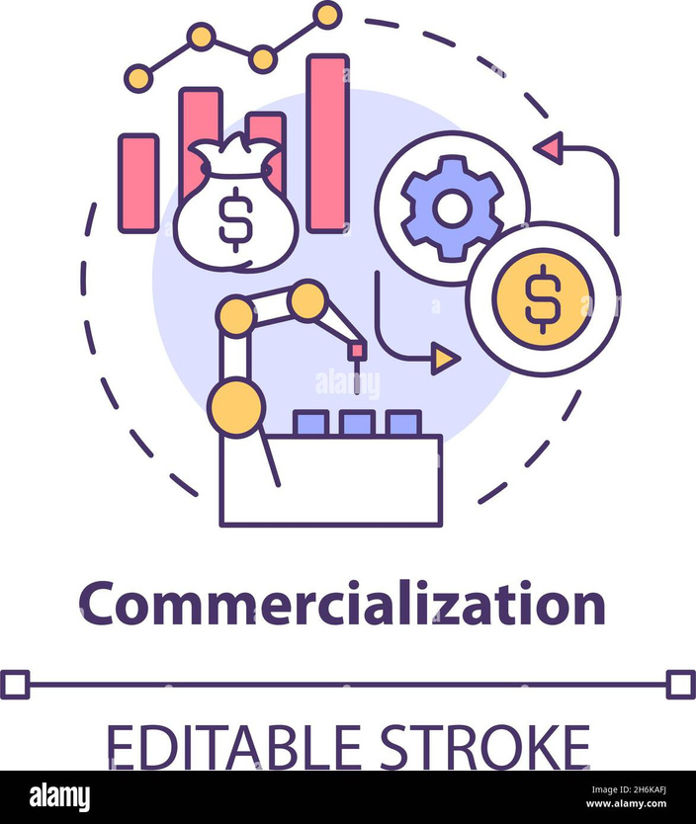
Commercialization
Investment
Labor: Software engineers, AI/ML specialists, data engineers, UI/UX designers, domain experts.
Infrastructure: Azure cloud for scalable APIs/DB/ML training, data warehouse for analytics, NLP/LLM API licensing.
Cost Recovery
Freemium: Core guidance free; paid premium add-ons.
Institutional Licensing: Subscription for schools, universities, ministries.
B2C SaaS: Monthly/annual plans for students and parents.
25-26J-336
|
PAGE: 32
|
2025/09/09
|

Slide 29
Commercialization
Target Market & Customer Profile
Primary: Sri Lankan A/L + university students.
Secondary: Non-traditional learners.
Users/Customers: Students, parents, institutions, career centers, government.
Value Proposition
Students: Personalized, data-driven guidance; aptitude + soft skill enhancement.
Parents: Clarity on ROI and career alignment.
Institutions: Scalable platform, reduced counselor workload.
Government: Minimized skill gaps, future-ready workforce.
Value Proposition / Technical Edge
Proprietary ML models for A/L & university prediction + ROI analysis.
BERT-based NLP for aptitude + soft skill evaluation.
Adaptive quizzes, personalized roadmaps, fairness-aware algorithms.
25-26J-336
|
PAGE: 33
|
2025/09/09
|

Slide 30

Thank You!
25-26J-336
|
PAGE: 34
|
2025/09/09
|

Slide 31

25-26J-336
|
PAGE: 35
|
2025/09/09
|

