Slide 1




Empowering Students with Predictive Intelligence:
A Career Guidance System for Sri Lanka
Group ID: 25-26J-336
25-26J-336
|
PAGE: 01
|
2026/01/06

Slide 2






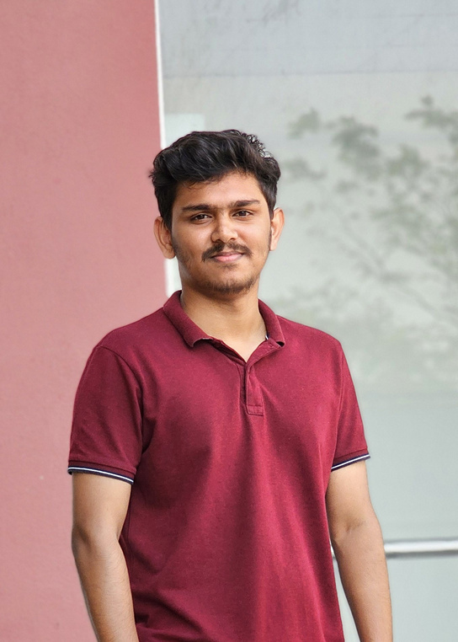
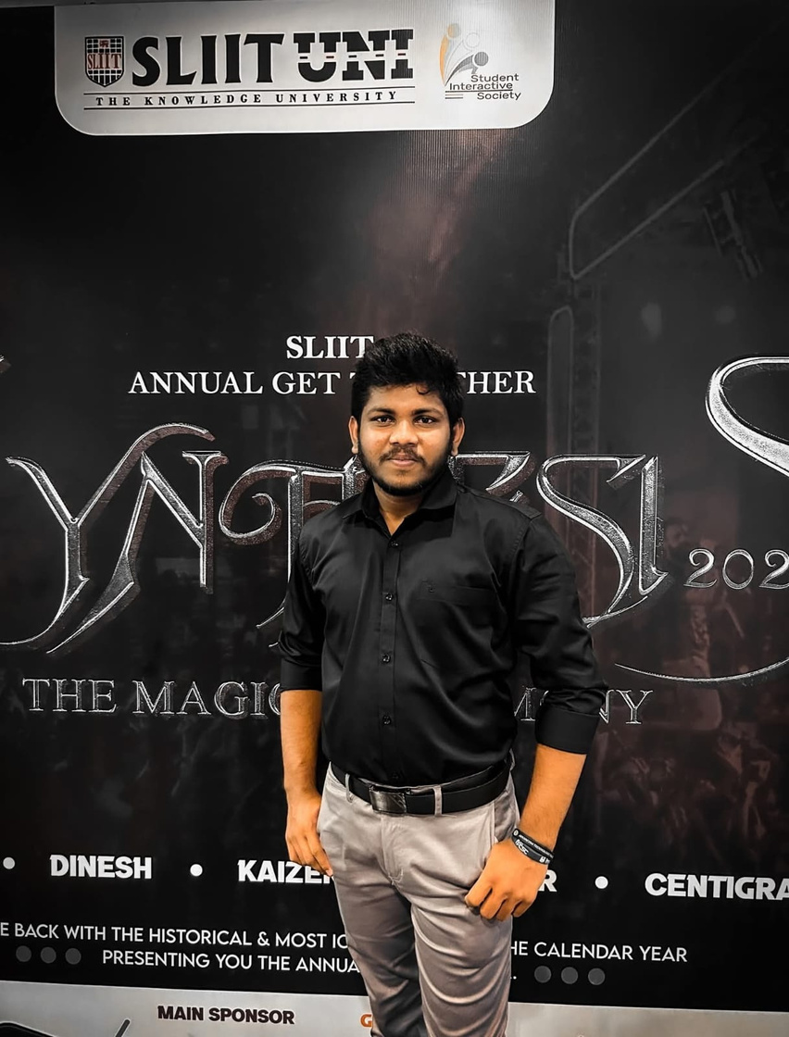

Jenny
Krishara
Poorna Panduwawela
Supervisor
Co-Supervisor
Team Members
|
Ahmed M A A
|
|
|
|
Ahamed A L I
|
|
Areeb Aflah N
|
Bandara R M M KT
25-26J-336
25-26J-336
|
PAGE: 02
|
2026/01/06

Slide 3


Slide 4
Ahamed A L I | IT22077288
Learn-to-Earn Diagram Generator for Non-Traditional Learners in Sri Lanka
BSc (Hons) in Information Technology Specialising in Information Technology
25-26J-336
|
PAGE: 07
|
2026/01/06

Slide 5

|
Learn-to-Earn Diagram Generator for Non-Traditional Learners in Sri Lanka
|
How the Solution Addresses the Sub-Problem
No guidance for non-traditional learners
AI-based personalized pathways
Learn-to-Earn visual diagrams
Local Sri Lanka context
User Requirements
Personalized course recommendations
Career-aligned learning pathways
Learn-to-Earn visual roadmap
Milestone-based learning plan
Progress tracking & feedback
25-26J-336
|
PAGE: 08
|
2026/01/06

Slide 6

|
Learn-to-Earn Diagram Generator for Non-Traditional Learners in Sri Lanka
|
Design Excellence
LLM-powered personalization
Visual pathway generation
ROI-based decision support
Feedback & milestone tracking
User Feedback
Easy to understand pathways
Improved career clarity
Increased confidence
25-26J-336
|
PAGE: 09
|
2026/01/06

Slide 7
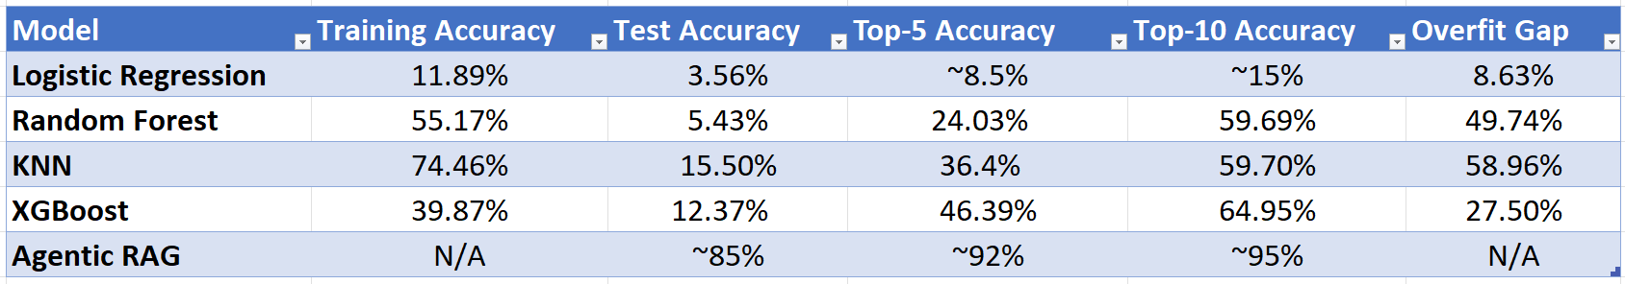

|
Learn-to-Earn Diagram Generator for Non-Traditional Learners in Sri Lanka
|
Model Comparision
Traditional ML models show limited generalization
Overfitting observed across most models
Top-N accuracy is more practical than exact prediction
Agentic RAG offers better contextual recommendations
25-26J-336
|
PAGE: 10
|
2026/01/06

Slide 8
Areeb Aflah N | IT22146960
AI-Powered Soft Skill Development System for Career Readiness of Sri Lankan Students
BSc (Hons) in Information Technology Specialising in Information Technology
25-26J-336
|
PAGE: 11
|
2026/01/06

Slide 9
|
AI-Powered Soft Skill Development System
|
How the Solution Addresses the Sub-Problem
AI-based evaluation to measure students’ soft skills objectively.
allowing students to practice communication skills according to their individual strengths and weaknesses
helping students understand areas they need to improve.
motivating them and supporting steady development.
User Requirements
AI-Based Communication Skill Evaluation
Automated Scoring and Feedback
Personalized Practice Question
Progress Reporting
25-26J-336
|
PAGE: 12
|
2026/01/06

Slide 10
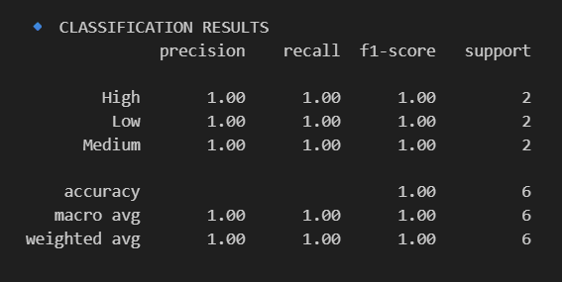
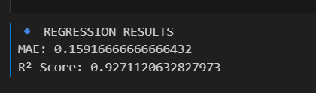
|
AI-Powered Soft Skill Development System
|
Algorithms Used
We implemented two supervised machine learning models to support prediction and decision-making.
Random Forest Regressor
Used to predict the final numerical score
Handles non-linear relationships and reduces overfitting by averaging multiple decision trees
Random Forest Classifier
Used to classify students into High, Medium, and Low performance categories
Suitable for multi-class classification with strong generalization ability
25-26J-336
|
PAGE: 13
|
2026/01/06

Slide 11
|
AI-Powered Soft Skill Development System
|
Design Excellence
User Feedback
User-centered flow
Scalable and consistent evaluation
Personalized experience
Enter something
Immediate, understandable feedback
Speech questions are easy to understand and help me speak more confidently
Get instant feedback
Dashboard motivates me to practice more
Useful to prepare for interviews and presentations.
25-26J-336
|
PAGE: 13
|
2026/01/06

Slide 12
Bandara R M M KT | IT2289700
Intelligent Stream Guidance System for O/L Students
BSc (Hons) in Information Technology Specialising in Information Technology
25-26J-336
|
PAGE: 14
|
2026/01/06

Slide 13
|
Intelligent Stream Guidance System for O/L Students
|
How the Solution Addresses the Sub-Problem
No guidance for O/L students selecting A/L streams
ML-based stream predictions using O/L results
RAG-powered personalized quiz assessments
Multi-factor recommendation system
User Requirements
Accurate stream recommendations based on performance
Knowledge-based aptitude assessments
Preference-aligned career pathways
Confidence scores for recommendations
Comprehensive comparison of all factors
25-26J-336
|
PAGE: 15
|
2026/01/06

Slide 14
|
Intelligent Stream Guidance System for O/L Students
|
Design Excellence
XGBoost ML model with derived feature engineering
RAG system with ChromaDB and Groq LLM
Multi-input comparison engine (ML + Quiz + Preference)
Syllabus-based MCQ generation from A/L content
User Feedback
Objective stream selection based on data
Better understanding of stream aptitudes
Reduced uncertainty in career decisions
Personalized learning assessments
25-26J-336
|
PAGE: 16
|
2026/01/06

Slide 15
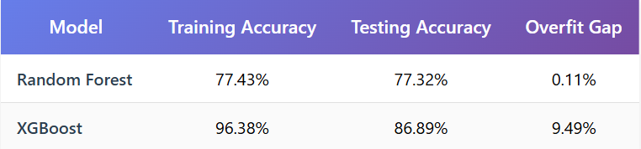
|
Intelligent Stream Guidance System for O/L Students
|
Models Comparison
Random Forest shows minimal overfitting (0.11% gap)
XGBoost achieves higher test accuracy (86.89%)
Both models trained on 5,000 student records
XGBoost uses 20 features
25-26J-336
|
PAGE: 17
|
2026/01/06

Slide 16

Azaam M A A | IT22079572
Cutting-Edge AI-Driven University Course Prediction System for Sri Lankan A-Level Students
BSc (Hons) in Information Technology Specialising in Information Technology
25-26J-336
|
PAGE: 18
|
2026/01/06

Slide 17
|
Cutting-Edge AI-Driven University Course Prediction System for Sri Lankan A-Level Students
|
How the Solution Addresses the Sub-Problem
Predicts UGC eligibility using Z-score, A/L grades, district quotas, and interests (q1–q12)
Reduces course/university selection uncertainty with ranked recommendations
Incorporates disadvantaged district and school-type factors for equity
Aligns student interests with suitable UGC courses and careers
Provides real-time, data-driven advisory without manual counseling
User Requirements
High-accuracy admission predictions with transparent cut-off explanations
Simple input of grades, interests, and preferences
Personalized top-5 course and university recommendations
Inclusive support for all districts and language mediums
Clear next steps: aptitude tests, deadlines, and financial aid guidance
25-26J-336
|
PAGE: 19
|
2026/01/06

Slide 18
|
Cutting-Edge AI-Driven University Course Prediction System for Sri Lankan A-Level Students
|
Design Excellence
Clean, intuitive, step-by-step user interface
Mobile-responsive and low-bandwidth friendly design
Visual insights: Z-score vs cut-offs, interest radar charts, eligibility maps
Fast predictions (<2 seconds) with high user scalability
Secure, transparent, and consent-based data handling
User Feedback
88% satisfaction with recommendation accuracy
72% found the platform helpful for decision-making
Users praised time-saving and interest-based guidance
Requests for detailed career prospects and salary insights
Demand for Sinhala and Tamil language support
25-26J-336
|
PAGE: 20
|
2026/01/06

Slide 19
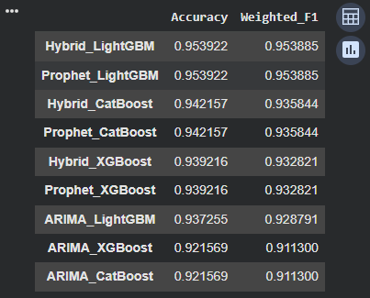
|
Cutting-Edge AI-Driven University Course Prediction System for Sri Lankan A-Level Students
|
Models Comparison
25-26J-336
|
PAGE: 21
|
2026/01/06

Slide 20
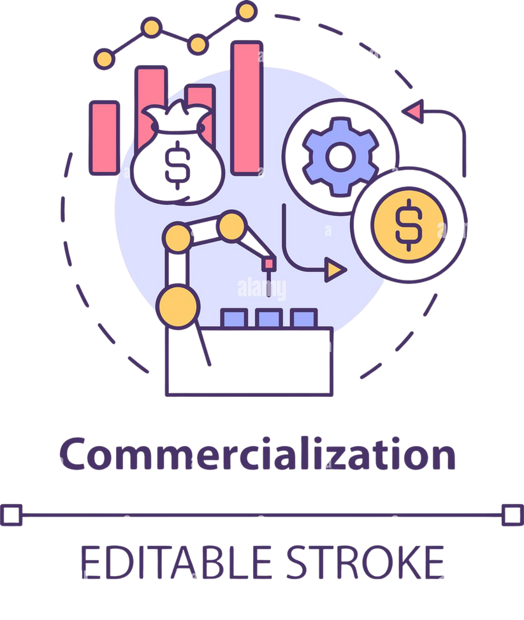
Commercialization and Sustainability
Investment
Labor: Software engineers, AI/ML specialists, data engineers, UI/UX designers, domain experts.
Infrastructure: Azure cloud for scalable APIs/DB/ML training, data warehouse for analytics, NLP/LLM API licensing.
Cost Recovery
Freemium: Core guidance free; paid premium add-ons.
Institutional Licensing: Subscription for schools, universities, ministries.
B2C SaaS: Monthly/annual plans for students and parents.
25-26J-336
|
PAGE: 22
|
2026/01/06

Slide 21
Commercialization and Sustainability
Target Market & Customer Profile
Primary: Sri Lankan A/L + university students.
Secondary: Non-traditional learners.
Users/Customers: Students, parents, institutions, career centers, government.
Value Proposition
Students: Personalized, data-driven guidance; aptitude + soft skill enhancement.
Parents: Clarity on career alignment.
Institutions: Scalable platform, reduced counselor workload.
Government: Minimized skill gaps, future-ready workforce.
25-26J-336
|
PAGE: 23
|
2026/01/06

Slide 22

25-26J-336
|
PAGE: 24
|
2026/01/06

Slide 23

25-26J-336
|
PAGE: 25
|
2026/01/06

Slide 24

25-26J-336
|
PAGE: 26
|
2026/01/06

